Slide 1



League of legends Champions GSA
LCG
LCG

Slide 2


Slide 4




Slide 6
League of Legends Champions GSA
ns GSA League of Legends Champion
LCG
24
gue of Legends Champions GSA Leag
GSA League of Legends Champions G

Slide 7
Victory Victory Victory Victory Victo
y Victory Victory Victory Victory Vic
LCG
24
tory Victory Victory Victory Victory
y Victory Victory Victory Victory Vic

Slide 8
League of Legends Champions GSA
LCG
24
s GSA League of Legends Champions

Slide 9
League of Legends Champions GSA
LCG
24
s GSA League of Legends Champions

Slide 10
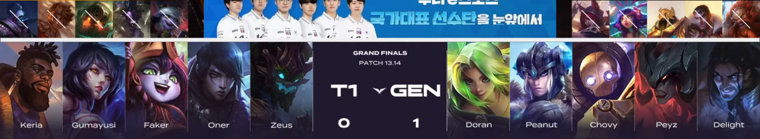
BAN PICK

Slide 12






Ro4 Stats
JJ.Gaming
K/D/A & GOLD
scbug 2 / 1 / 3 9,056
오정준이 7 / 2 / 6 9,895
원딜학개론 9 / 2 / 7 12,015
동균이는 멋져 3 / 0 / 13 8,644
중성가족부 2 / 1 / 9 8,815
LCG 24

Slide 13
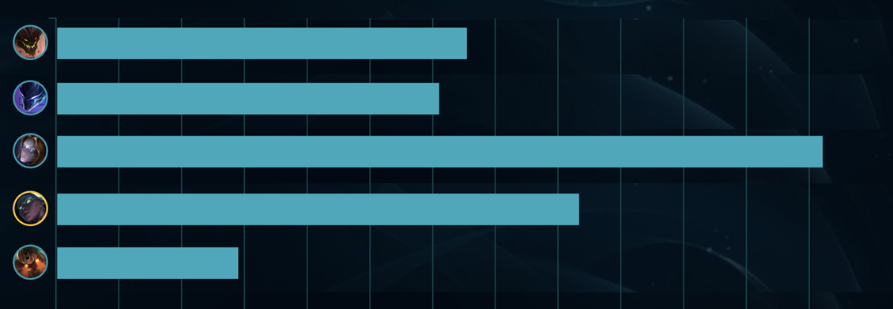
Ro4 Stats
JJ.Gaming
Damage Dealt
LCG 24

Slide 14





Ro4 Stats
T0
K/D/A & GOLD
바바다라기 4 / 1 / 5 11,185
불린양고기 7 / 1 / 5 9,491
민초나라치킨공주 10 / 0 / 5 10,523
but somehow 2 / 1 / 9 8,729
surrin 1 / 0 / 9 6,432
LCG 24

Slide 15
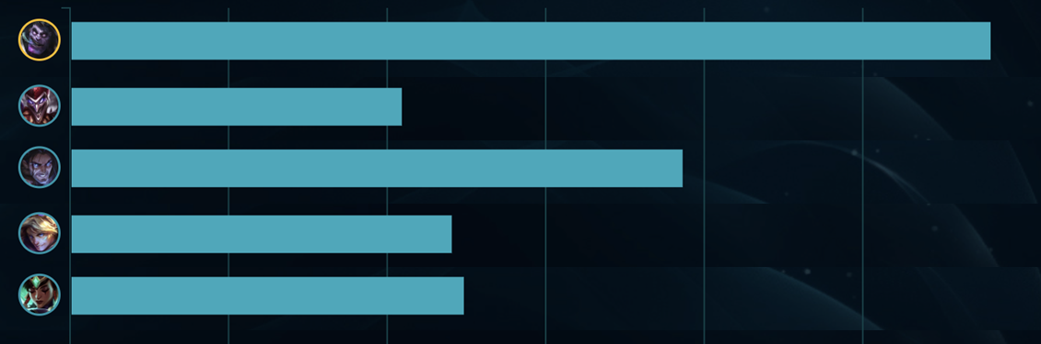
Ro4 Stats
T0
Damage Dealt
LCG 24

